Slide 1

Technological Disruptions in the Betting Industry
Explore the transformative impact of technology and regulations shaping the betting landscape towards 2025, highlighting key trends and stakeholder implications.
Presented by Ongalo Glenn

Slide 2
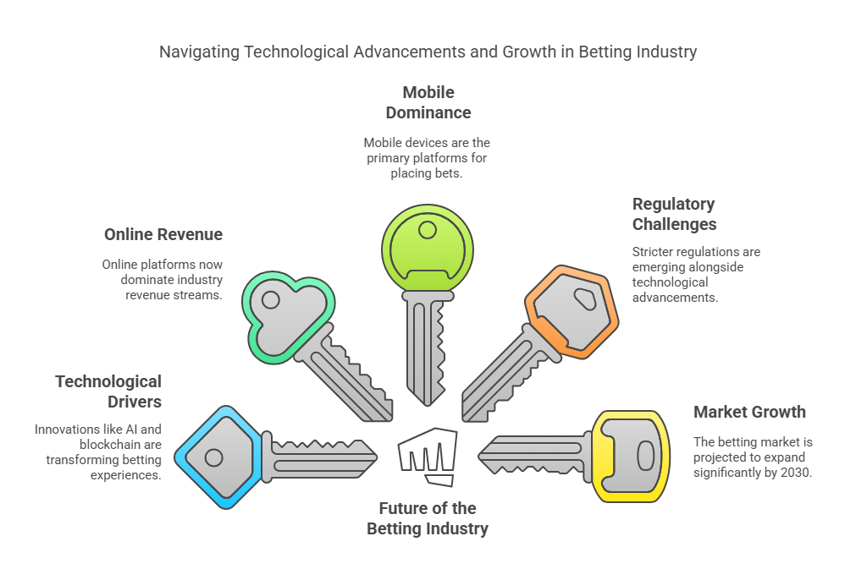
Overview of the Betting Industry

Slide 3

AI and Machine Learning Innovations
Exploring key innovations in AI and ML in Betting
Predictive Analytics
Fraud Detection
Real-time odds generation using player performance and historical data, improving accuracy by 35%.
AI monitors for unusual betting patterns, leading to a 62% increase in suspicious activity detection.
Responsible Gambling
Personalization
Identifies problematic gambling patterns, triggering interventions like cooling-off periods.
Customizes recommendations based on user preferences

Slide 4

Blockchain and Cryptocurrency Integration
Transparency:
Immutable ledgers record all transactions, reducing payment disputes by 78%
BetDEX Exchange and other platforms leverage blockchain for tamper-proof processes
Public verification of odds calculations and random number generation
Smart Contracts:
Self-executing contracts for complex bet types and parlays
Cryptocurrency Adoption:
Over 70% of sportsbooks now accept cryptocurrencies like Bitcoin, appealing to users with speed.
Blockchain Platforms:
Platforms like Solana and Ethereum Layer-2 are expanding, with decentralized exchanges up 145% yearly.

Slide 5

Enhancements in User Experience with Immersive Technologies
Exploring the Impact of VR and AR on User Engagement
Virtual Betting Lounges:
Simulated stadium environments with 3D avatars and social interaction
Major operators report 3x engagement duration in VR environments
Integration with live sports streaming creates seamless viewing/betting experience
Augmented Reality Overlays:
Real-time stats, odds, and player data displayed during live events
Mobile AR applications showing 189% growth in user adoption since 2023
Enhanced User Experience:
Interactive 3D visualizations of betting markets and outcomes
Virtual "watch parties" combining social interaction and group betting

Slide 6

Mobile-First Platforms and Micro-Betting
Mobile-First Platforms and Micro-Betting
Platform Dominance:
80-90% of all wagers now placed via smartphones and tablets
Native apps outperforming web apps by 3.5x in user retention
Biometric authentication (fingerprint, face ID) standard for security
Live Streaming Integration:
In-app viewing of 15,000+ live events monthly across major platforms
Picture-in-picture betting interfaces while watching matches
Latency reduced to <2 seconds, enabling truly real-time betting
Micro-Betting Explosion:
Short-duration bets (next point, next pitch) growing 215% annually
Appeals to younger demographics (21-34 age group)
AI-powered micro-markets: 300+ betting options per game
Average user places 8-12 micro-bets per viewing session
User Experience Enhancements:
One-tap betting options reduce friction in transaction process
Personalized push notifications driving 38% higher conversion rates
Cross-platform synchronization between devices (mobile, desktop, wearables)

Slide 7

eSports and Virtual Sports Market Expansion
Market Expansion:
eSports betting market reached $12.7 billion in 2024, projected to hit $20 billion by 2027
Demographics skew younger: 68% of bettors under age 35
Virtual Sports Growth:
AI-generated matches now a $1.3 billion market segment
24/7 availability driving adoption in off-hours and between seasons
Realistic physics engines and machine learning creating highly unpredictable outcomes
Virtual horse racing and soccer leading with 43% and 28% market share respectively
Technology Convergence:
Blockchain verification ensuring fair play in eSports competitions
VR viewership options for major tournaments driving 4.2x higher engagement
NFT integration with team ownership and player cards
Emerging Opportunities:
Mobile eSports titles creating new betting markets with broader appeal
Fantasy eSports growing 78% year-over-year
Collegiate eSports leagues expanding betting options in regulated markets

Slide 8

AI-Driven Interventions:
New York, New Jersey, and Pennsylvania now mandate AI monitoring tools
Automatic detection of concerning patterns:
Escalating deposit amounts (>40% increase week-over-week)
Betting >60% of deposited funds within 24 hours
Multiple failed deposit attempts in short timeframes
National Self-Exclusion Systems:
Responsible Online Gaming Association (ROGA) launching shared registry in Q2 2025
Biometric verification preventing circumvention of exclusion lists
Mandatory Player Protections:
Pre-commitment systems requiring users to set limits before betting
Cool-down periods after significant losses (enforced 24-hour waiting period)
Reality checks displaying time spent and money lost at regular intervals
Transparency Requirements:
Clear display of odds in decimal, and fractional formats
Detailed win probability explanations required for complex bet types
Requirement to show actual vs. expected returns on previous bets

Slide 9

Advertising Restrictions Overview
The SAFE Bet Act (U.S.):
Limits promotional bonuses to max 25% of initial deposit
Prohibits targeting users under 25 through digital advertising
Requires warning labels occupying 20% of ad space
Restricts use of celebrities and athletes in betting promotions
Regional Controls:
Australia: Max 2 gambling ads per hour during prime time
UK: Complete ban on ads during live sporting events ("whistle-to-whistle" ban)
Canada: Restrictions on using terms like "free bets" and "risk-free"
Digital Advertising Limitations:
Age-gating requirements across social media platforms
Prohibition of remarketing to users who visited addiction resources
Geo-fencing exclusion zones around schools, addiction treatment centers
Keyword restrictions preventing targeting vulnerable search terms
Industry Response:
Self-regulatory bodies emerging to develop responsible marketing codes
Major operators reducing ad spend by 18% amid regulatory pressure
Shift toward content marketing and loyalty programs over aggressive acquisition tactics

Slide 10


Auditable Transactions:
Ireland, Malta, and Isle of Man require blockchain-based transaction records
All betting histories must be immutably stored for minimum 5 years
Regulators gaining real-time access to operator transaction ledgers
92% reduction in payout disputes reported in blockchain-compliant jurisdictions
Anti-Money Laundering:
Enhanced KYC/AML procedures utilizing blockchain verification
Transaction pattern analysis to detect layering and structuring attempts
Cross-chain monitoring to identify linked accounts and suspicious fund flows
U.S. Treasury Department developing specific guidance for crypto betting platforms
Crypto-Specific Requirements:
Source of funds verification for crypto deposits over $1,000 equivalent
Stable cryptocurrency requirements for holding player balances
Wallet whitelisting to prevent third-party transfers
Standardization Efforts:
EU's Markets in Crypto-Assets (MiCA) regulation affecting betting operators
Industry consortium developing uniform blockchain compliance standards
Certified blockchain auditors becoming mandatory in tier-1 jurisdictions

Slide 11

Key Industry Challenges
Exploring Notable Issues in the Sector
Ethical AI Concerns:
Privacy implications of behavioral tracking and prediction
Algorithmic accountability for responsible gambling detection
Bias in AI systems potentially affecting odds and recommendations
Market Saturation:
Customer acquisition costs up 43% year-over-year
Integrity Risks:
Micro-betting creating new opportunities for match manipulation
Athlete data security and potential misuse concerns
Social media threats and harassment of athletes after betting outcomes
Regulatory Complexity:
Compliance costs averaging 12-18% of operational expenses
Jurisdictional variations requiring market-specific technology solutions
Conflicting requirements between territories complicating expansion
Stringent penalties: fines reaching 10% of annual turnover for violations
Technical Challenges:
Latency issues affecting live betting experiences
Cybersecurity threats targeting customer data and deposits
Integration complexity between legacy systems and new technologies

Slide 12

Industry Opportunities
AI-Powered Customer Experience:
Voice-activated betting through smart speakers and virtual assistants
Predictive modeling for personalized betting suggestions
Automated customer service handling 78% of support inquiries
Advanced analytics providing bettors with professional-level insights
Churn prediction and intervention increasing retention by 28%
Blockchain Innovations:
Tokenized loyalty programs with transparent reward structures
NFT collectibles tied to betting achievements and milestones
Decentralized betting exchanges reducing operator margins
Cross-platform digital identity solutions streamlining verification
Fan engagement tokens creating new betting markets
Growth Markets:
African mobile betting expanding at 34% CAGR
Female bettors growing at twice the rate of male bettors
Media Integration:
Broadcaster partnerships embedding betting content in streams
Second-screen experiences synchronizing with live events
Interactive TV applications enabling bet placement via remote
Sports content creators driving 35% of new customer acquisition
Connected TV apps showing 4x engagement over traditional platforms
Data Monetization:
Anonymized behavioral data creating new revenue streams
Predictive algorithms licensed to other industries
Enhanced sports data partnerships driving content innovation
AI-generated insights sold as premium subscription services

Slide 13
Emerging Trends for 2025
Trend | Description | Impact Metrics
AI-Powered Betting | Real-time insights using machine learning | 42% increase in user session length
Blockchain Integration | Transparent processes with smart contracts | 78% reduction in payment disputes
eSports Expansion | VR/AR integration with gaming competitions | $20B market value projected by 2027
Mobile Innovations | Advanced features with reduced friction | 89% of new accounts created on mobile
Regulatory Technology | Automated compliance and monitoring | 65% reduction in compliance costs
Voice Interfaces | Betting through smart speakers and assistants | 325% growth in voice-activated wagers
Cross-Platform Integration | Seamless experience across devices | 58% higher retention for multi-device users
Data Visualization | Interactive odds and statistics displays | 37% better conversion on complex bets

Slide 14
Regional Market Analysis
Region | Market Size | Growth Rate | Key Trends | Regulatory Status
North America | $32.8B | 18.5% CAGR | Mobile micro-betting; AI integration | Fragmented state-by-state approach
Europe | $27.3B | 8.3% CAGR | VR experiences; Strict responsible gambling | Harmonization efforts underway
Asia-Pacific | $18.5B | 24.7% CAGR | Mobile-first; eSports dominance | Varying from banned to fully regulated
Latin America | $9.4B | 30.2% CAGR | Crypto adoption; Soccer focus | Major markets opening (Brazil, Mexico)
Africa | $3.8B | 34.1% CAGR | Mobile money integration; Sports focus | Limited regulation with emerging frameworks
Middle East | $2.1B | 15.3% CAGR | High-roller focus; Fantasy sports | Strictly regulated with specific exceptions

Slide 15

Conclusion
Industry undergoing rapid digital transformation requiring strategic adaptation
Success factors:
Balancing technological innovation with regulatory compliance
AI and blockchain driving efficiency while maintaining user trust
Focus on responsible gambling becoming competitive advantage
Mobile and immersive experiences creating differentiation
Platform consolidation inevitable as compliance costs increase
Regional strategies essential for navigating varied regulations
Future outlook:
Market consolidation expected among mid-tier operators
Technology partnerships becoming crucial for smaller players
Successful companies will prioritize sustainable growth over aggressive acquisition
Integration of entertainment and betting experiences continuing
Responsible innovation remains the key to long-term viability

Slide 16

Thank You

